Slide 1
Project Name: GATED COMMUNITY ERM
Project Members:
Vaishnavi Thorat Shraddha Sabne
(210543181116) (210543181104)
Aditya Abu Rina Borchate
(210543181002) (210543181078)

Slide 2
Content
Abstract
Introduction
Objectives
Problem Statement
Advantages Of Systems
Applications
Technologies Used
Entity Relationship Diagram
Future Scope
Conclusion

Slide 3
Abstract
In Conventional housing society management system ,all society works are done manually. Society chairman have to keep all the society expenses report on paper file. At some time if this data is needed ,then retrieving this data is very slow and tiresome work.
This problem need to be solved so that members can come to know what is happening in society. Generating bill and sending it to each society member is also a tiresome work. Sometime members did not get bills and chances of being lost. Payment collection is also big task in society.
So the system is needed to overcome these problems and reduce human effforts.

Slide 4
Introduction
Generally, in Society all the work is decided in meetings and maintenance bills, contact no of members are recorded on the papers. There is no automated system for doing all the things that generally happens in society, so that members can come to know what is happening in society. The Society Management System allows members to login with their own account and get updated with society happenings. Society Management System is the website portal to reduce conflicts among society members. The system has automated functionality for calculating monthly maintenance bill and member can view their bill status on their account.

Slide 5
Objectives
Providing a web application which improves living feasibility of the Residents in society
Monitoring system which tends to make people feel safer about living in a gated community
User friendly system which enables user to interact via chats, notifications & provides feasibility in maintaining records.

Slide 6
Problem Statement
Existing system for a society is based on our traditional way of keeping records and details on paper and registers. Access of these details and papers are not granted to common member in absence of the authority. It is hard to manage all the society system with pen and paper. It gets really hard to maintain the records and then keep track of past records. Hence this system is proposed to overcome the flaws of the existing system and giving power to the admin of the society so that he/she will be able to manage the society easily.

Slide 7
Advantages Of Systems
This online society management solution is fully functional and flexible.
The monitoring of the society management and the overall business becomes easy and includes the least paper work.
It brings transparency and efficiency in the working of housing societies.

Slide 8
Applications
Access from Anywhere Even if the residents are out of town, they will know what is going on back home through the app. It is a great way to stay connected and remain in touch with the community. The app also comes in handy for the older generation who do not use computers or laptops.
A Virtual Notice BoardInstead of wasting paper on printing notices and dropping them on every doorstep, you can use the online system to post updates to reach every person. You can also send notifications for important alerts, so nobody misses out on the information.

Slide 9
Have Emergency Contacts in One PlaceA page dedicated to all relevant emergency contacts like security staff, committee chair, nearby hospitals, and police is necessary. This way, the residents can lodge complaints or call for help at the time of need.
Group Chat for SocializingCities can be alienating, and it is hard to break the ice with neighbours, but the group chats feature on the app can remove that awkwardness
make new friends and become an active part of your community virtually and eventually in real life too.

Slide 10
Technologies Used:-
Spring Framework
Html
Css
Bootstrap
MySql
Hibernate
ReactJs

Slide 11

Spring Framework
Spring Framework is a Java platform that provides comprehensive infrastructure support for developing Java applications. Spring handles the infrastructure so you can focus on your application.
Features of Spring Framework:
Lightweight
Aspect Oriented Programming (AOP)
Transaction Management
Container

Slide 12

MySQL
MySQL, the most popular Open Source SQL database management system, is developed, distributed, and supported by Oracle Corporation.
Features of MySQL:
Software is Open Source.
Server works in client/server or embedded systems.
Database Server is very fast, reliable, scalable, and easy to use.

Slide 13
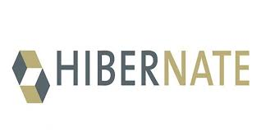
Hibernate
Hibernate is an object–relational mapping tool for the Java programming language.
It provides a framework for mapping an object-oriented domain model to a relational database.
Hibernate handles object–relational impedance mismatch problems by replacing direct, persistent database accesses with high-level object handling functions.

Slide 14
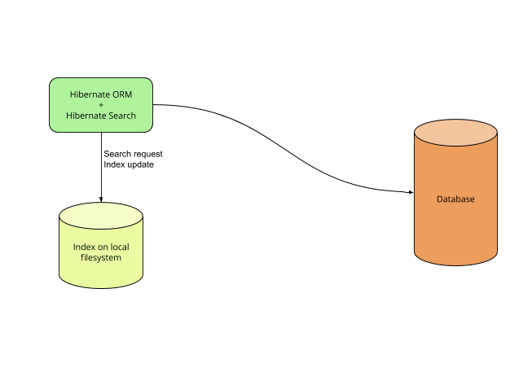
Features of MySQL:
Open Source and Lightweight
Fast Performance
Database Independent Query
Automatic Table Creation
Simplifies Complex Join

Slide 15
ReactJs
React (also known as React.js or ReactJS) is a free and open-source front-end JavaScript library for building user interfaces or UI components. It is maintained by Facebook and a community of individual developers and companies.
React can be used as a base in the development of single-page or mobile applications.

Slide 16
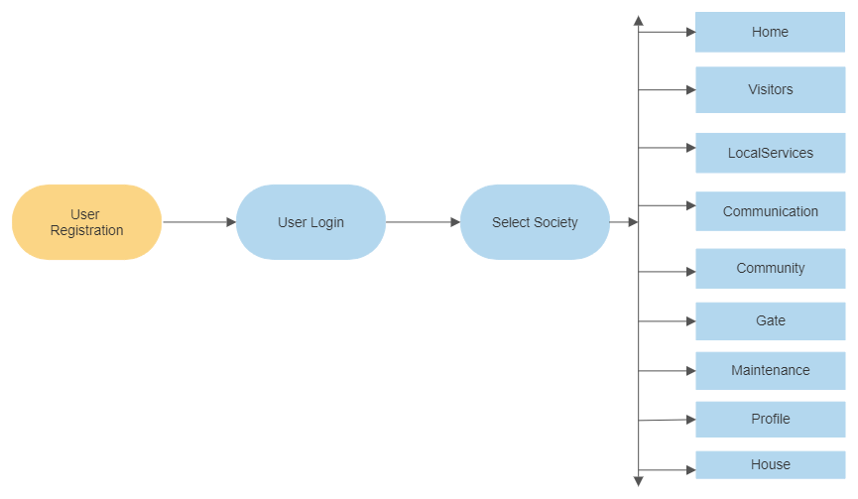
Flow Chart

Slide 17
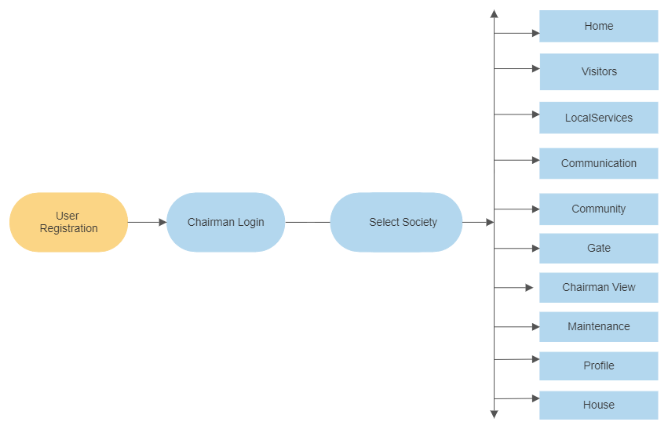

Slide 18


Slide 19


Slide 20
Future Scope
This project can be enhanced further by adding club house booking, online voting system, online payment facility for the members to reduce the extra work of the admin. The software is flexible enough to be modified and implemented as per future requirements.
Message and Email alerts for various happenings in the society can be added to the system so that users do not miss the updates and happenings of the society
This project can be enhanced further by Developing a Mobile App. Also we can Develop a Full Fledged accounting module.

Slide 21
Conclusion
Society management system puts forth the actual working of a society. Administration, management, payment calculation, worker management, visitor management, etc. similar to a society are the key features of our project. User can access services and functionalities from the society anywhere and anytime for their own comfort.

Slide 22


